Slide 1

MINI PROJECT
MENTOR-Dr.Nayantara Kotoky
TEAM NO-22

Slide 2
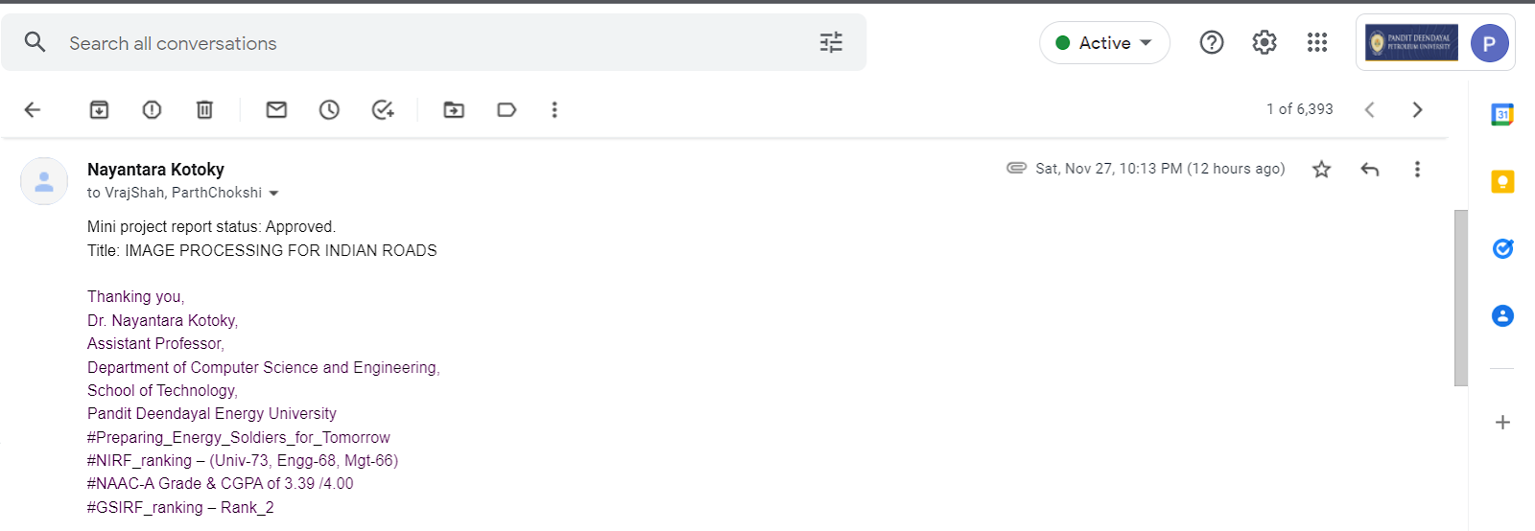
EMAIL CONFIRMATION

Slide 3
TOPIC –IMAGE PROCESSING ON INDIAN ROADS(pOTHOLES DETECTION)
Area- Machine Learning & Computer Vision

Slide 4

PROBLEM STATEMENT
In developing nations such as India, the vehicular growth rate is increasing exponentially which is worsening the traffic operations .The Ministry of Road Transport and Highways report on Road accidents in India stated that road accidents increased by a rate of 0.46 % in the year 2020 when compared to 2019. The major challenges faced in the road transportation sector are: Potholes which are formed due to heavy rains and dense movement of vehicles on the poorly constructed roads. Pothole formation has given rise to accidents and loss of human lives
Due to this there is a need to develop a model which can analyze and detect poor road conditions like potholes. This project aims in building a system which can detect the poor road conditions and can notify the driver as well as the government beforehand to improvise the road conditions.

Slide 5
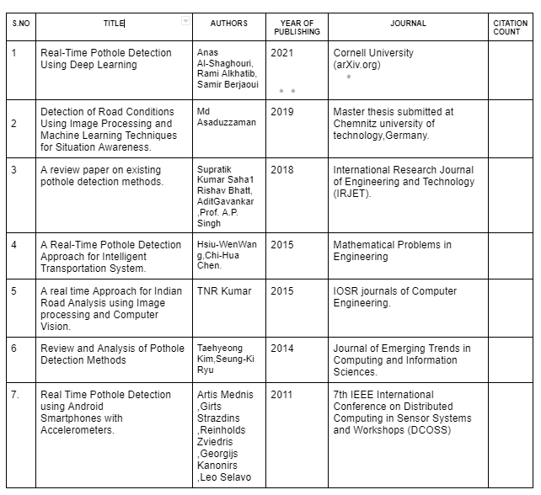
RESEARCH PAPERS

Slide 6
LITERATURE REVIEW
1. “A Research of Pavement Potholes Detection Based on Three-Dimensional Projection Transformation” by Wang Jian, Qiu Hanxing, ZhangWei, Xie Jianfang
In order to detect the three-dimensional cross-section of pavement potholes more effectively, this paper proposes a method that employs the optical imaging principle of three-dimensional projection transformation to obtain pictorial information of potholes’ cross-sections in pothole detection. Multiple digital image processing technologies, including image preprocessing, binarization, thinning, three-dimensional reconstruction, error analysis, and compensation are conducted in the series of image analyses and processing. Experimental results indicate that the method is markedly superior to traditional methods in many aspects. For its simple detection principle, low cost, and high efficiency, the method suggests great practical and promoting value.

Slide 7
2) “Detection of Road Conditions Using Image Processing and Machine Learning Techniques for Situation Awareness.” by Md Asaduzzaman
In this paper Image processing and machine learning have been combined for this system for detecting in real-time. Machine learning has been applied to maintain signs detection. Image processing has been applied for detecting lanes and potholes. The detection system will provide a lane mark with colored lines, the pothole will be a marker with a red rectangular box and for a road Maintenance sign, the system will also provide information of maintenance sign as maintenance sign is detected. By observing all these scenarios, the driver will realize the road condition.

Slide 8
3)” Real-Time Pothole Detection Using Deep Learning” by Anas Al-Shaghouri, Rami Alkhatib, Samir Berjaoui
The images used for training were collected by cell phone mounted on the windshield of the car, in addition to many images downloaded from the internet to increase the size and variability of the database. Second, various object detection algorithms are employed and compared to detect potholes in real-time like SDD-TensorFlow, YOLOv3 Darknet53, and YOLOv4 Darknet53. YOLOv4 achieved the best performance with 81% recall, 85% precision, and 85.39% mean Average Precision (mAP). The speed of processing was 20 frames per second. The system was able to detect potholes from a range of 100 meters away from the camera. The system can increase the safety of drivers and improve the performance of self-driving cars by detecting potholes ahead of time.

Slide 9
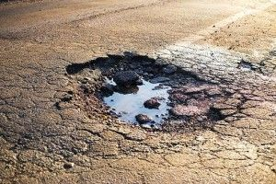
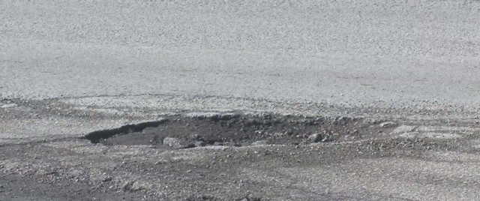
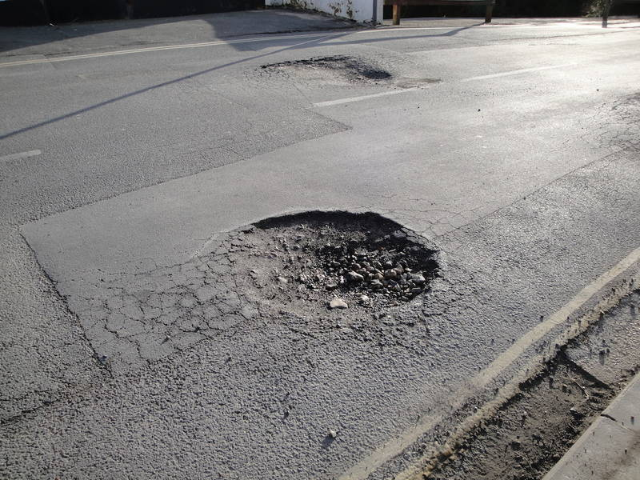
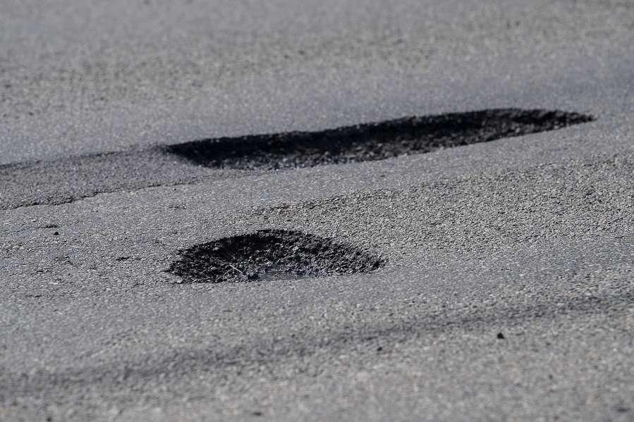
DATASETS
LINKS
https://www.kaggle.com/chitholian/annotated-potholes-dataset
https://www.kaggle.com/sachinpatel21/pothole-image-dataset
Description
A zipped folder containing 600+ .jpg images of the Road with Potholes.
Note: These images are web scrapped from google, it might have some noisy or duplicate images.
SAMPLE IMAGES:

Slide 10
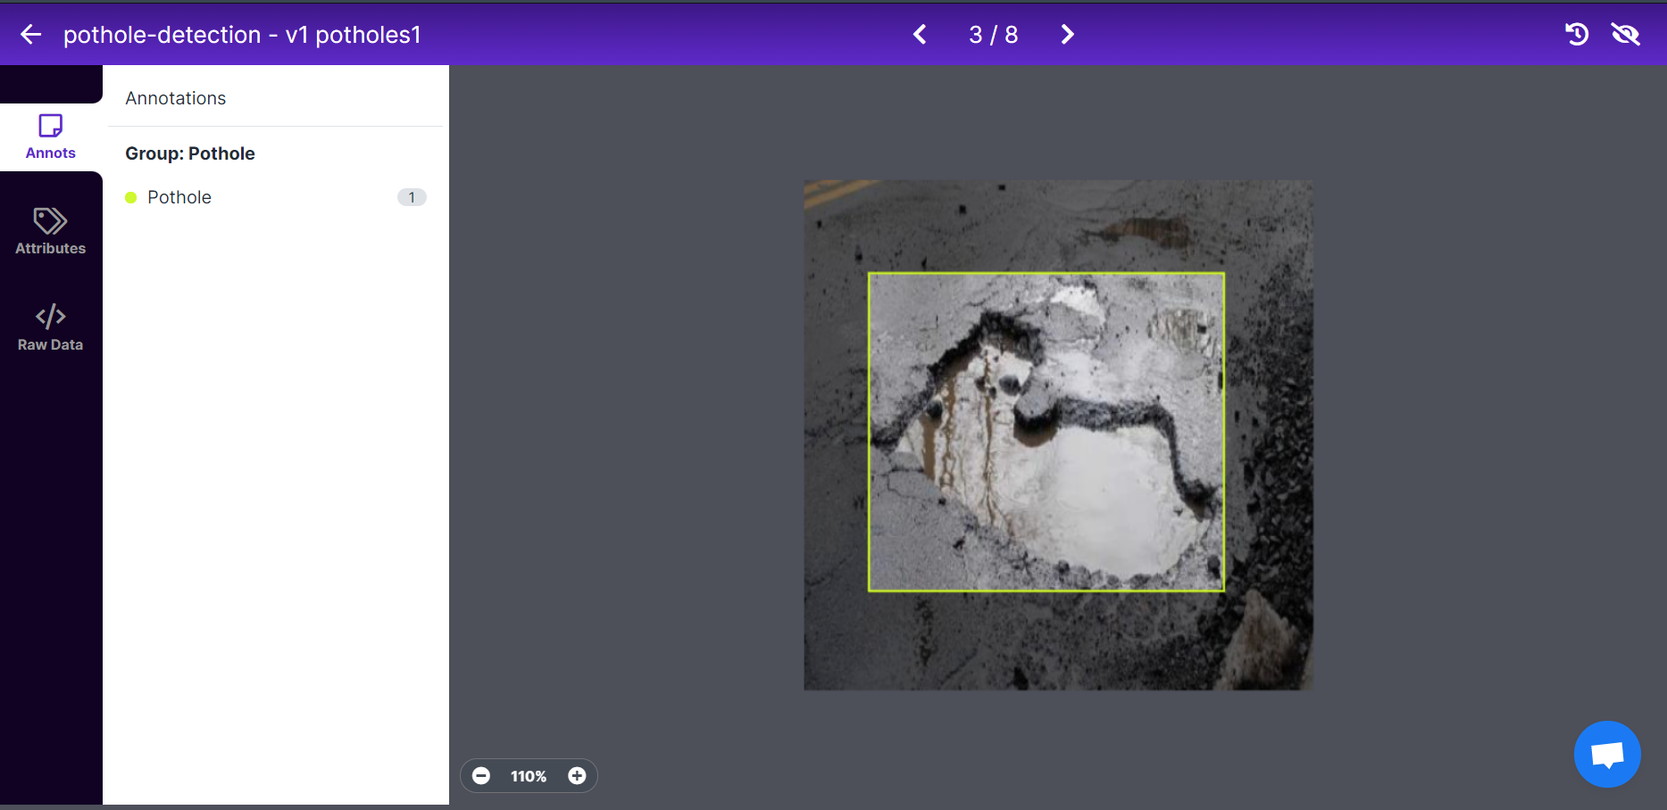
ANNOTATING IMAGES FOR TRAINING PURPOSE:

Slide 11
PROPOSED WORK
Pothole detection is being carried out using two techniques namely image processing and machine learning techniques. Those two techniques are used for a study of the detection and occurrence of potholes. In this project, we propose both of them individually and then a combination of the techniques to see how image pre-processing can affect the performance of a deep learning model.

Slide 12
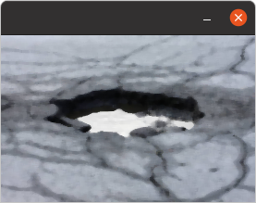
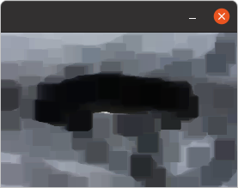
Experiment 1: Image PROCESSING TECHNIQUES
a)Median Blur: The Median blur operation is similar to the other averaging methods. Here, the central element of the image is replaced by the median of all the pixels in the kernel area. This operation processes the edges while removing the noise. It is very useful in removing salt and pepper noise.
b)Erosion: Erosion erodes away the boundaries of the foreground objects. It is used to diminish the features of an image.

Slide 13
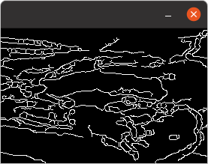
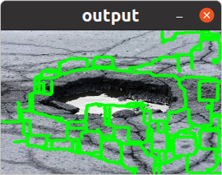
c)Canny Edge detection: The Canny edge detector is an edge detection operator that uses a multi-stage algorithm to detect a wide range of edges in images.
d)Contour Detection: When we join all the points on the boundary of an object, we get a contour. Typically, a specific contour refers to boundary pixels that have the same color and intensity.

Slide 14
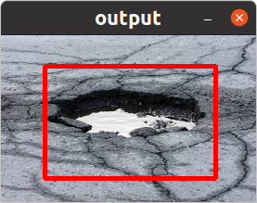
e) Bounding Box Prediction: Finally, place a bounding box across the contour.

Slide 15
Experiment 2: DEEP lEARNING APPROACH- YOLO
About YOLO:
Yolo is a Deep Learning algorithm specially designed for image classification and Object Detection (Deep Convolutional Neural Network).
The model was trained over a week by the authors of the paper “You Only Look Once: Unified, Real-Time Object Detection” and obtained a whopping accuracy of 88%.
Yolo had been trained on a very large dataset.
YOLO runs at 45 Frames per second so it has a latency of 15ms.
It has an mAP (mean Average Precision) of 63.4% which is the highest among real-time object detectors.
Our Approach: Transfer Learning
Transfer learning is about speeding up a new learning task by reusing the results of previous learning.
The already-trained model is referred to as the base model. Transfer learning involves retraining the base model or creating a new model on top of the base model.
In our project, we will be using the YOLO v5 model for our custom object detection, that is, pothole detection.
YOLO was chosen after going through a number of research papers and techniques used in them and it was found by us that it has the best real-time object detection accuracy.
‹#›

Slide 16
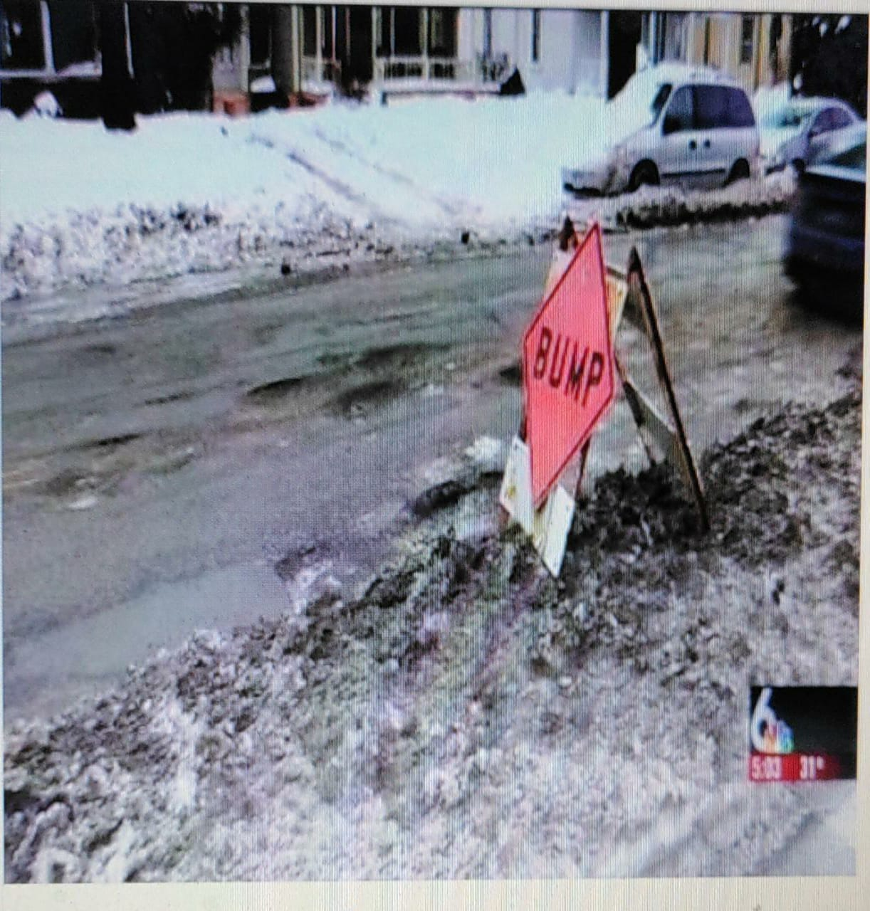
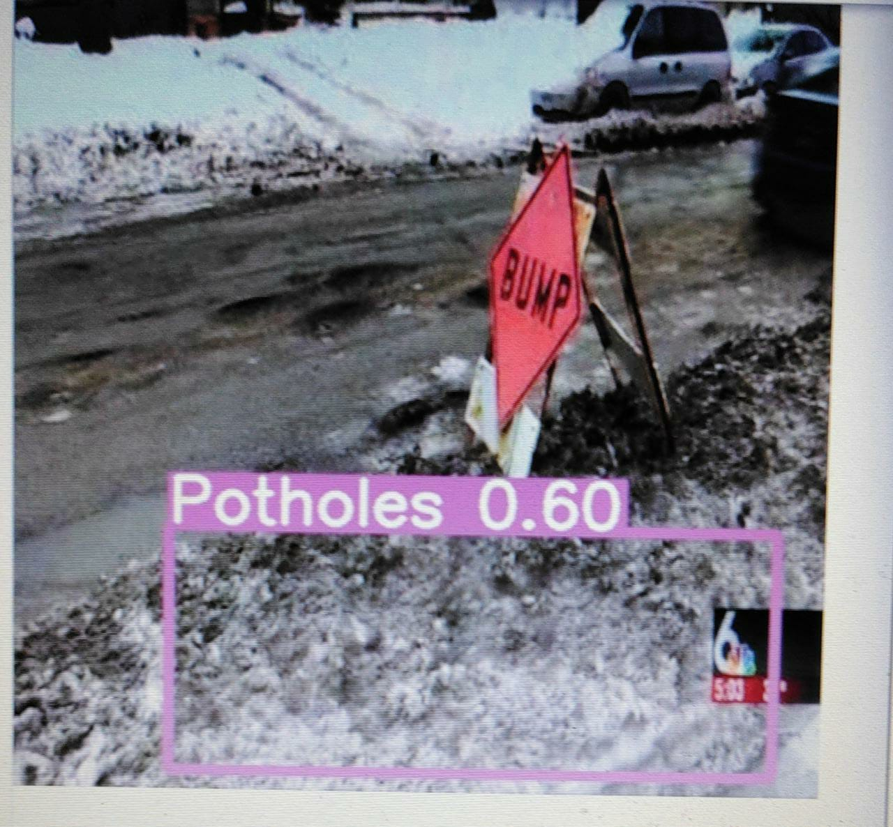
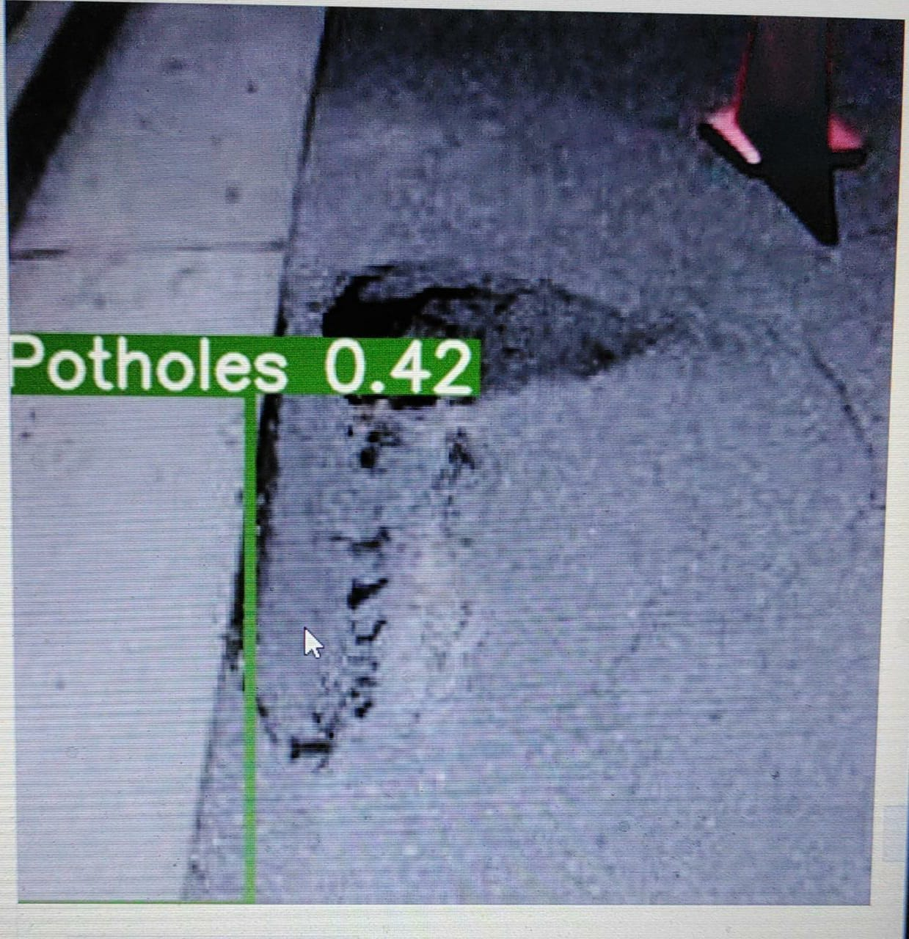
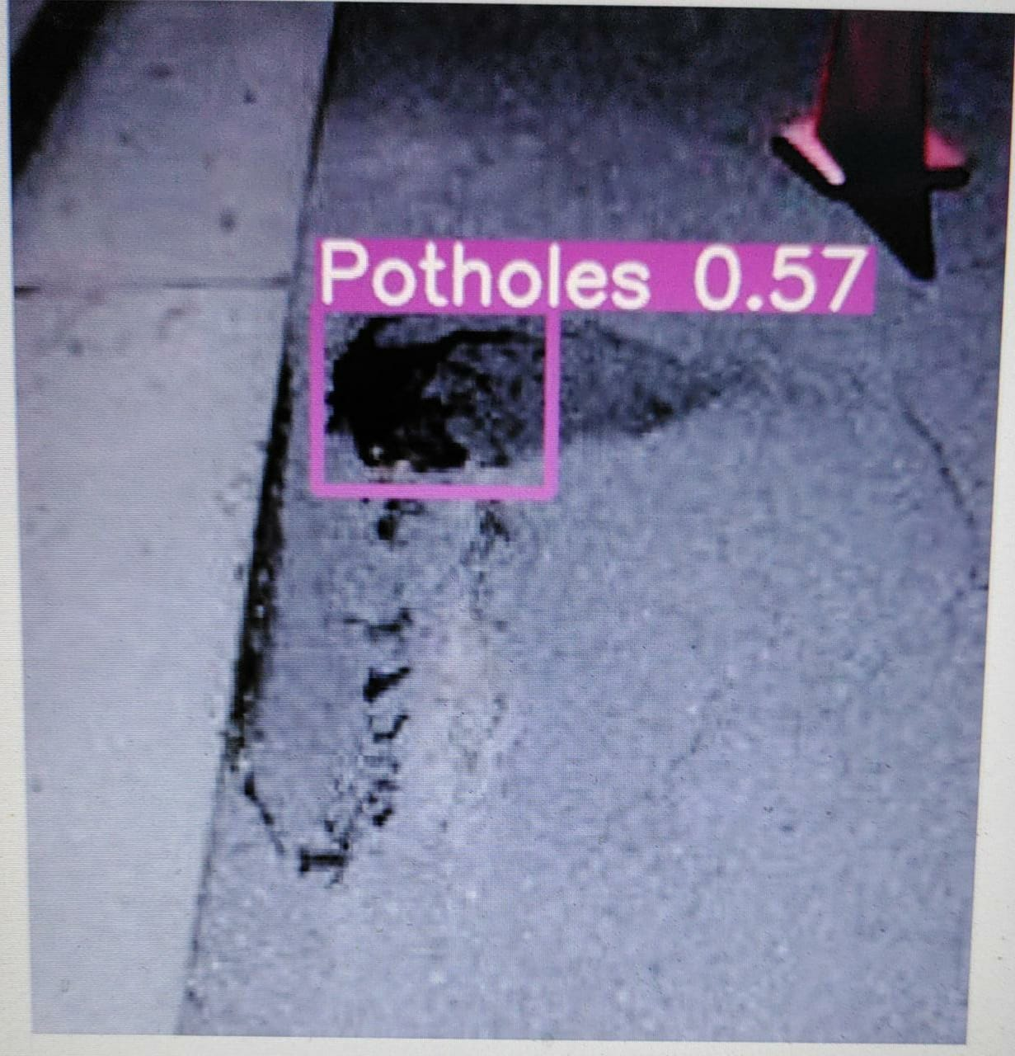
Experiment 3: COMBINATION OF 2 TECHNIQUES(Image Processing & Machine learning)
After performing the above techniques successfully we thought of combining the 2 techniques and verifying the result.
We first labeled the dataset and trained the YOLOv5 Model with that dataset.
After that, we applied the Median Blur technique of image processing on the same dataset and then trained the YOLOv5 model.
After that, we applied Erosion on the dataset obtained from step 3 and then again trained the model.
Finally, we compared the result in all the 3 cases and this gave us information on how image pre-processing can affect the accuracy of the deep learning model.
These are some of the output images of YOLOv5 model in the following respective order:
Normal Image Dataset b) Image processing techniques applied

Slide 17
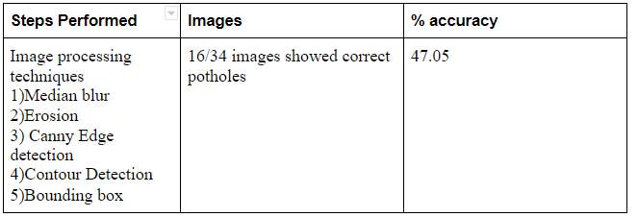
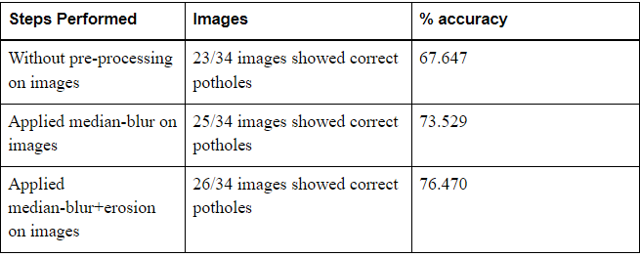
results
Experiment-1: Image Processing Technique
Experiment-2: Deep Learning Approach(YOLO)

Slide 18
FUTURE DIRECTIONS
The image pre-processing steps used here surely increased the accuracy of the model. In future,more such image processing techniques can be identified and applied as a pre-processing step which will enhance the efficiency of the model.
Also, this system can be integrated with Google maps.Images from satellites can be passed to this model which can detect any potholes present on roads and then it can be viewed on google maps. This will help the government to improve the road conditions.

Slide 19

19

